Slide 1
Brain Tumor Detection From Mri Images With Ibm Watson Studio
M.Kalyan
P.Kalyan Sundar
V.Samhita
S.Siddhartha
V.Vivek naik

Slide 2
INDEX
1.Introduction
2.Purpose
3.Training the Machine
4.Testing
5.Applications
6.Advantages & Disadvantages
8.Result
7.Conclusion

Slide 3
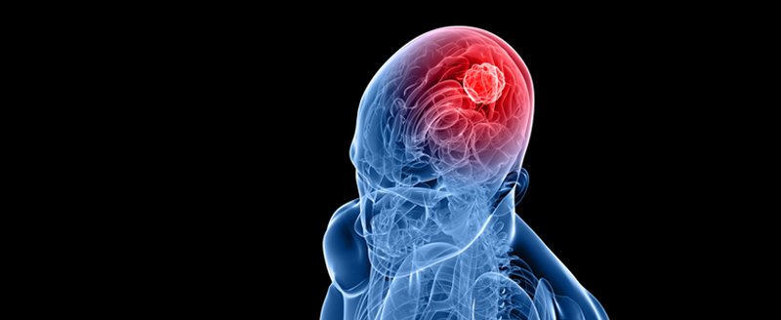
INTRODUCTION
1. Brain tumor is one of the most rigorous diseases in the medical science
2. A primary malignant brain tumor is a rare type of cancer accounting for only about 1.4% of all new cancer cases in the U.S.
3.General Symptoms of Brain Tumor
Headache , Nausea , Vomiting , Blurred vision , Drowsiness
4. But the main concern with the stereotactic biopsy is that it is not 100% accurate which may result in a serious diagnostic error followed by a wrong clinical management of the disease.

Slide 4
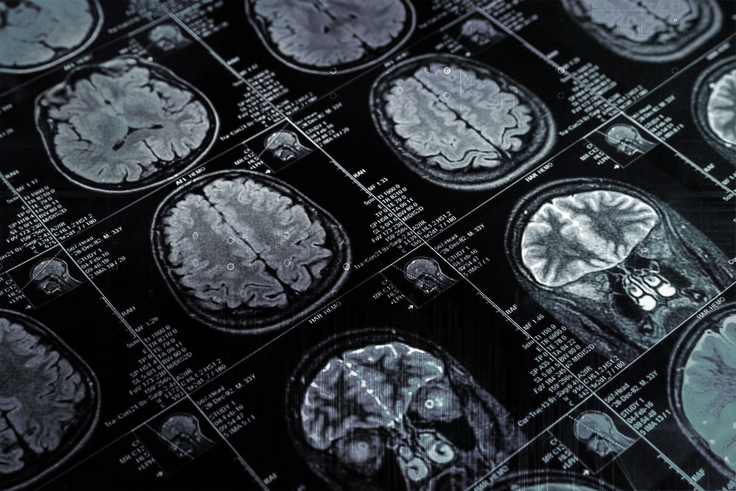
Purpose
→ Automated defect detection in medical imaging using machine learning has become
the emergent field in several medical diagnostic applications. Its application in the
detection of brain tumor in MRI is very crucial as it provides information about
abnormal tissues which is necessary for planning treatment. Studies in the recent
literature have also reported that automatic computerized detection and diagnosis
of the disease, based on medical image analysis, could be a good alternative as it
would save radiologist time and also obtain a tested accuracy. Furthermore ,
e
if computer algorithms can provide robust and quantitative measurements of tumor
depiction, these automated measurements will greatly aid in the clinical management
of brain tumors by freeing physicians from the burden of the manual depiction of tumors.

Slide 5
Training the Machine
We have used Python which is a statistical mathematical programming language like R instead of MATLAB .
Import image DataGenerator and configure it
Apply image DataGenerator functionality to train and test set
Import required model building libraries
Initialize the model , add convolution layers , pooling layer , flatten layer and dense layer
Compile the model fit and save the model

Slide 6
Testing the Machine
The model is to be tested with different images to know if it is predicting correctly.
Import the packages that are used to load the model and get the predictions.
Pre-processing the image includes converting the image to array and resizing
according to the model. Give the pre-processed image to the model to know
to which class your model belongs to.

Slide 7
Advantages and Disadvantages
Advantages:
1.It is considered as the best ml technique for image classification due to high accuracy.
2.Image pre-processing required is much less compared to other algorithms.
3.It is used over feed forward neural networks as it can be trained better in case of complex
images to have higher accuracies.
4. . It reduces images to a form which is easier to process without losing features which are critical
for a good prediction by applying relevant filters and reusability of weights .
Disadvantages:
1. It requires a large training data.
2. It requires appropriate model.
3. It is time consuming
4. It is a tedious and exhaustive procedure

Slide 8
Applications
The main application of this model is to predict the provided image is
brain tumor or not. It is well trained so that it will predict the correct
data

Slide 9
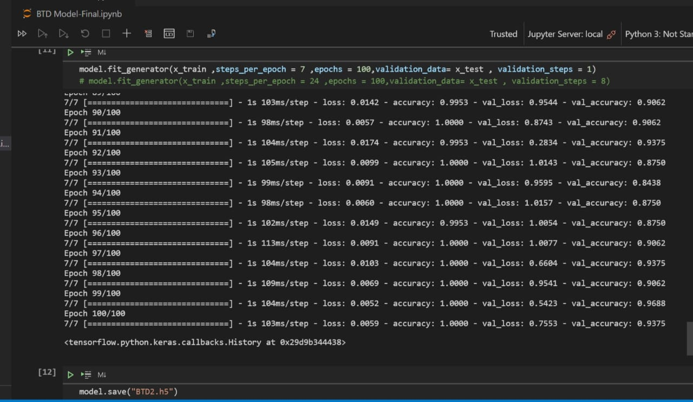
Result
From the above picture we can tell that the accuracy of the model is 100% and the value accuracy is 93.75%. For a best model the accuracy should be >90% but we had it over 94% so our’s is a nice model. Which can used in the real life for the practical use.

Slide 10
Conclusion:
Without pre-trained Keras model, the train accuracy is 97.5% and validation accuracy is
90.0%.The validation result had a best figure of 91.09% as accuracy.It is observed that
without using pre-trained Keras model, although the training accuracy is >90%, the overall
accuracy is low unlike where pre-trained model is used.

Slide 11
THANK YOU

